Slide 1
Genetic Algorithms
Optimization Techniques

Slide 2
Genetic Algorithm
Based on Darwinian Paradigm
Intrinsically a robust search and optimization mechanism
Reproduction
Competition
Survive
Selection

Slide 3
Conceptual Algorithm
Initialize Population
Evaluate Fitness
Yes
satisfy constraints ?
No
Select Survivors
Randomly Vary Individuals
Output Results

Slide 4
Genetic Algorithm Introduction 1
Inspired by natural evolution
Population of individuals
  Individual is feasible solution to problem
Each individual is characterized by a Fitness function
  Higher fitness is better solution
Based on their fitness, parents are selected to reproduce offspring for a new generation
  Fitter individuals have more chance to reproduce
  New generation has same size as old generation; old generation dies
Offspring has combination of properties of two parents
If well designed, population will converge to optimal solution

Slide 5
Algorithm
BEGIN
Generate initial population;
Compute fitness of each individual;
REPEAT /* New generation /*
FOR population_size / 2 DO
Select two parents from old generation;
/* biased to the fitter ones */
Recombine parents for two offspring;
Compute fitness of offspring;
Insert offspring in new generation
END FOR
UNTIL population has converged
END

Slide 6
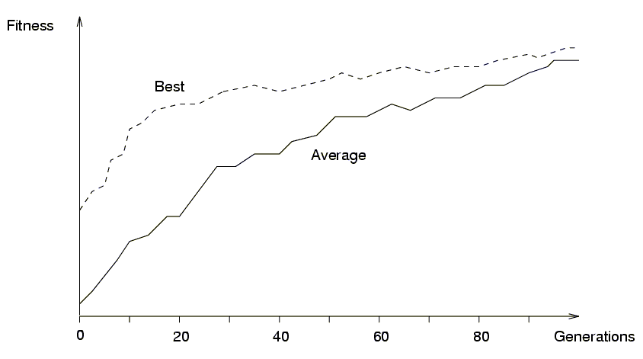
Example of convergence

Slide 7
Introduction 2
Reproduction mechanisms have no knowledge of the problem to be solved
Link between genetic algorithm and problem:
  Coding
  Fitness function

Slide 8
Basic principles 1
Coding or Representation
  String with all parameters
Fitness function
  Parent selection
Reproduction
  Crossover
  Mutation
Convergence
  When to stop

Slide 9
Basic principles 2
An individual is characterized by a set of parameters: Genes
The genes are joined into a string: Chromosome
The chromosome forms the genotype
The genotype contains all information to construct an organism: the phenotype
Reproduction is a “dumb” process on the chromosome of the genotype
Fitness is measured in the real world (‘struggle for life’) of the phenotype

Slide 10
Coding
Parameters of the solution (genes) are concatenated to form a string (chromosome)
All kind of alphabets can be used for a chromosome (numbers, characters), but generally a binary alphabet is used
Order of genes on chromosome can be important
Generally many different codings for the parameters of a solution are possible
Good coding is probably the most important factor for the performance of a GA
In many cases many possible chromosomes do not code for feasible solutions

Slide 11
Genetic Algorithm
Encoding
Fitness Evaluation
Reproduction
Survivor Selection

Slide 12
Encoding
Design alternative → individual (chromosome)
Single design choice → gene
Design objectives → fitness

Slide 13
Example
Problem
  Schedule n jobs on m processors such that the maximum span is minimized.
Design alternative: job i ( i=1,2,…n) is assigned to processor j (j=1,2,…,m)
Individual: A n-vector x such that x_{i} = 1, …,or m
Design objective: minimize the maximal span
Fitness: the maximal span for each processor

Slide 14
Reproduction
Reproduction operators
  Crossover
  Mutation

Slide 15
Reproduction
Crossover
  Two parents produce two offspring
  There is a chance that the chromosomes of the two parents are copied unmodified as offspring
  There is a chance that the chromosomes of the two parents are randomly recombined (crossover) to form offspring
  Generally the chance of crossover is between 0.6 and 1.0
Mutation
  There is a chance that a gene of a child is changed randomly
  Generally the chance of mutation is low (e.g. 0.001)

Slide 16
Reproduction Operators
Crossover
  Generating offspring from two selected parents
    Single point crossover
    Two point crossover (Multi point crossover)
    Uniform crossover

Slide 17
One-point crossover 1
Randomly one position in the chromosomes is chosen
Child 1 is head of chromosome of parent 1 with tail of chromosome of parent 2
Child 2 is head of 2 with tail of 1
Randomly chosen position
Parents: 1010001110 0011010010
Offspring: 0101010010 0011001110

Slide 18
Reproduction Operators comparison
Single point crossover
→
Cross point
Two point crossover (Multi point crossover)
→

Slide 19
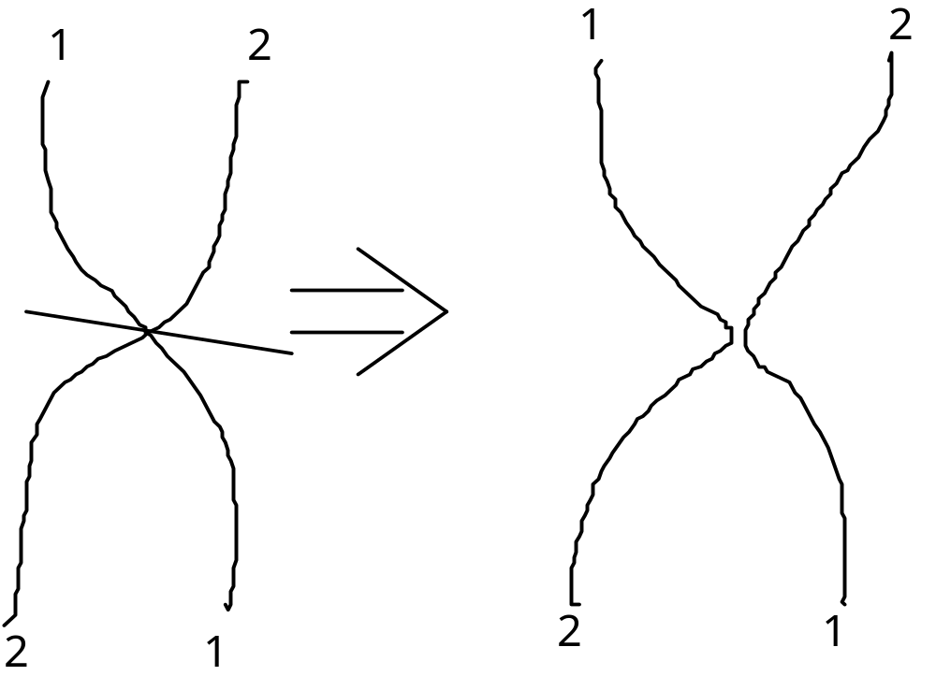
One-point crossover - Nature

Slide 20
Two-point crossover
Randomly two positions in the chromosomes are chosen
Avoids that genes at the head and genes at the tail of a chromosome are always split when recombined
Randomly chosen positions
Parents: 1010001110 0011010010
Offspring: 0101010010 0011001110

Slide 21
Uniform crossover
A random mask is generated
The mask determines which bits are copied from one parent and which from the other parent
Bit density in mask determines how much material is taken from the other parent (takeover parameter)
Mask: 0110011000 (Randomly generated)
Parents: 1010001110 0011010010
Offspring: 0011001010 1010010110

Slide 22
Reproduction Operators
Uniform crossover
→
Is uniform crossover better than single crossover point?
  Trade off between
    Exploration: introduction of new combination of features
    Exploitation: keep the good features in the existing solution

Slide 23
Problems with crossover
Depending on coding, simple crossovers can have high chance to produce illegal offspring
  E.g. in TSP with simple binary or path coding, most offspring will be illegal because not all cities will be in the offspring and some cities will be there more than once
Uniform crossover can often be modified to avoid this problem
  E.g. in TSP with simple path coding:
    Where mask is 1, copy cities from one parent
    Where mask is 0, choose the remaining cities in the order of the other parent

Slide 24
Reproduction Operators
Mutation
  Generating new offspring from single parent
  Maintaining the diversity of the individuals
    Crossover can only explore the combinations of the current gene pool
    Mutation can “generate” new genes
→

Slide 25
Reproduction Operators
Control parameters: population size, crossover/mutation probability
  Problem specific
  Increase population size
    Increase diversity and computation time for each generation
  Increase crossover probability
    Increase the opportunity for recombination but also disruption of good combination
  Increase mutation probability
    Closer to randomly search
    Help to introduce new gene or reintroduce the lost gene
Varies the population
  Usually using crossover operators to recombine the genes to generate the new population, then using mutation operators on the new population

Slide 26
Parent/Survivor Selection
Strategies
  Survivor selection
    Always keep the best one
    Elitist: deletion of the K worst
    Probability selection : inverse to their fitness
    Etc.

Slide 27
Parent/Survivor Selection
Too strong fitness selection bias can lead to sub-optimal solution
Too little fitness bias selection results in unfocused and meandering search

Slide 28
Parent selection
Chance to be selected as parent proportional to fitness
Roulette wheel
To avoid problems with fitness function
Tournament
Not a very important parameter

Slide 29
Parent/Survivor Selection
Strategies
  Parent selection
    Uniform randomly selection
    Probability selection : proportional to their fitness
    Tournament selection (Multiple Objectives)
      Build a small comparison set
      Randomly select a pair with the higher rank one beats the lower one
        Non-dominated one beat the dominated one
        Niche count: the number of points in the population within
        certain distance, higher the niche count, lower the
        rank.
    Etc.

Slide 30
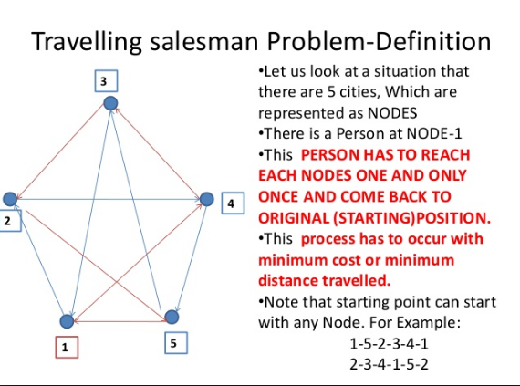

Slide 31
TSP Example: 30 Cities

Slide 32
Solution _{i} (Distance = 941)

Slide 33
Solution _{j}(Distance = 800)

Slide 34
Solution _{k}(Distance = 652)

Slide 35
Best Solution (Distance = 420)

Slide 36
Overview of Performance

Slide 37
Issues for GA Practitioners
Choosing basic implementation issues:
  representation
  population size, mutation rate, ...
  selection, deletion policies
  crossover, mutation operators
Termination Criteria
Performance, scalability
Solution is only as good as the evaluation function (often hardest part)

Slide 38
Benefits of Genetic Algorithms
Concept is easy to understand
Modular, separate from application
Supports multi-objective optimization
Good for “noisy” environments
Always an answer; answer gets better with time
Inherently parallel; easily distributed

Slide 39
Benefits of Genetic Algorithms (cont.)
Many ways to speed up and improve a GA-based application as knowledge about problem domain is gained
Easy to exploit previous or alternate solutions
Flexible building blocks for hybrid applications
Substantial history and range of use

Slide 40
When to Use a GA
Alternate solutions are too slow or overly complicated
Need an exploratory tool to examine new approaches
Problem is similar to one that has already been successfully solved by using a GA
Want to hybridize with an existing solution
Benefits of the GA technology meet key problem requirements

Slide 41
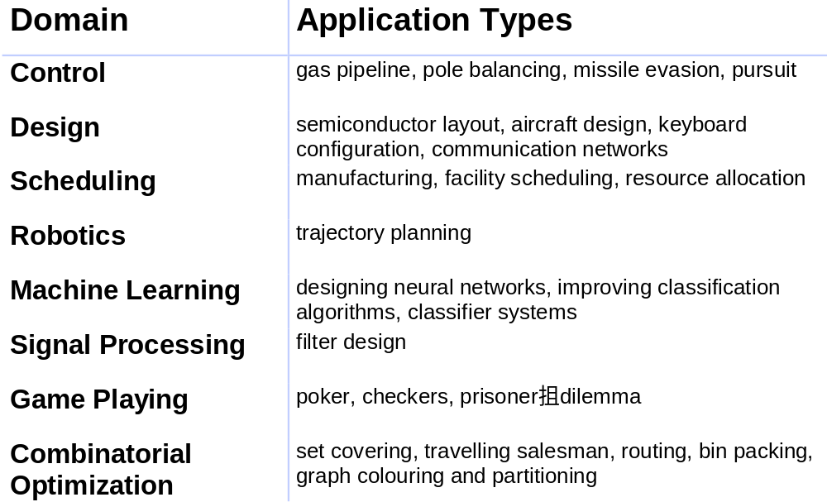
Some GA Application Types

Slide 42
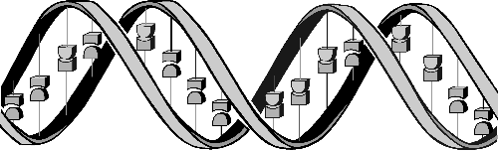
Conclusions
Question: ‘If GAs are so smart, why ain’t they rich?’
Answer: ‘Genetic algorithms are rich - rich in application across a large and growing number of disciplines.’
- David E. Goldberg, Genetic Algorithms in Search, Optimization and Machine Learning

